Slide 1
Microbiology Dep.
Second year
Parasitology
Second Lec.
Lecturer: Assist prof.
Dr. Sally Ahmed
Intestinal protozoa
Amoeba
General characters of Amoeba:
· All the members move by pseudopodium.
· Having Trophozoite stage.
· Multiplication by binary division.
· Some of them parasitic, other free living.
· Generic classification depends on structures of nuclear contents.
· Commonly parasitizing the large intestine of man, except
Entamoeba gingivalis, which parasitized the oral cavity.

Slide 2
Members of this family are:
1) Entamoeba histolytica
2) Entamoeba coli
3) Endolimax nana
4) Iodamoeba buetschlii
5) Entamoeba gingivalis
6) Dientamoeba fragilis
Phylum: protozoa
Subphylum: Sacromastigophora
Class: Sarcodina
Genus: Entamoeba
Species: E. histolytica

Slide 3
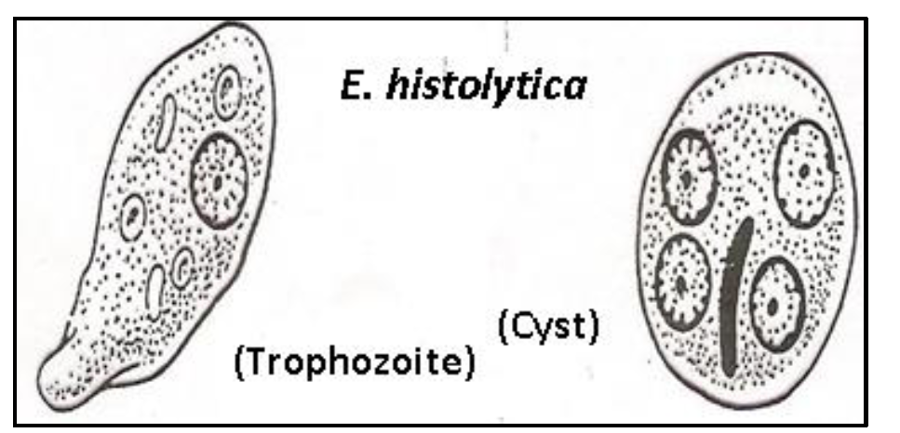
Entamoeba histolytica
Disease: Amebiasis
Geographical distribution Cosmopolitan mainly in tropical & subtropical area.
Morphology:
It has four stages: Trophozoite, precyst, cyst, metacyst The stages recognized in the feces are trophozoites & cysts. The other two found only inside the host body (precyst, metacyst)

Slide 4
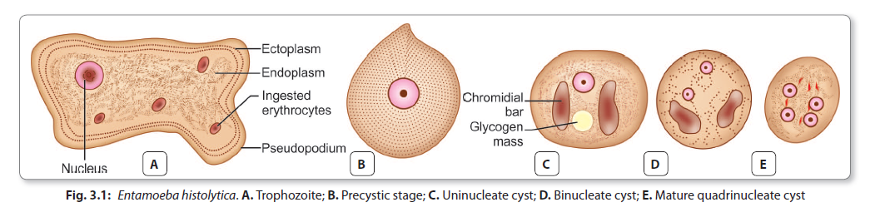
Life Cycle:

Slide 5
Pathogenesis:
• Infection with E. histolytica leads to formation of colonization.
• The damage caused by E. histolytica is Chemical & Mechanical
• Trophozoite may lodge in the crypts of large intestine
• Lesion result from invasion leading to superficially minute cavity (are result of lytic necrosis of the parasite on colon mucosa).
• More colonizing & more lytic action leading to narrow channel, which lead to base of the mucosa.
• In many cases, the Amoeba erode a passage into muscularis mucosa then sub mucosa.
• It can spread radially to surrounding tissues. (If there is no secondary bacterial infection, there is no tissue reaction).
• Any extraintestinal lesion is secondary to primary lesion in large intestine except cutaneous lesion of the genitalia.

Slide 6
· So the early uncomplicated amebic lesions are minute opening with slightly raised yellowish ring in mucosa leading into a deeper enlargement in the submucosa with tunneled connection between two or more lesions leading to cuts off the blood supply sloughing of overlying layers.
As the lesion becomes chronic by bacterial infection tissue reaction & cell infiltration, with neutrophilic leukocytes & fibroblasts tend to form a wall around the ulcer & over hanging edges become thickened.
Symptoms:
The incubation period (the time or duration from time of exposure till first symptoms appears) is varying from few days to 3 months or even a year.
At time or more amoebic granulomas (amebomas) develop in the wall of colon or rectum.
The patient with amebic dysentery has tenesmus, abdominal cramps.
The abdominal pain & tenderness are mostly in the lower quadrants of the abdomen, on the right side. Clinically sometime mistaken for appendicitis.
Extraintestinal symptoms depend on the organ affected.
Hepatic abscess presents with fever, enlarged tender are
mostly in the lower quadrants of the abdomen, on the right side, clinically sometimes mistaken for appendicitis.

Slide 7
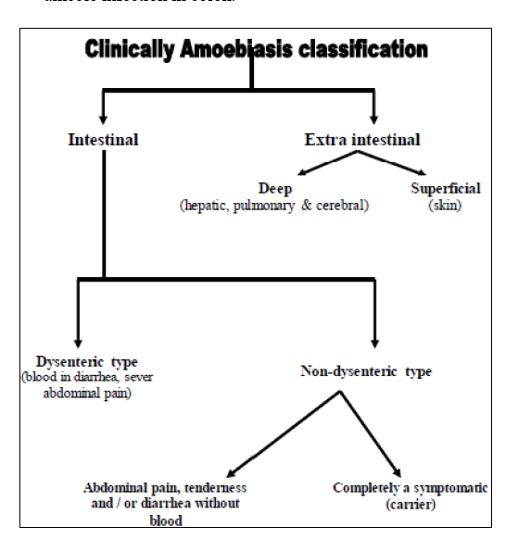

Slide 8
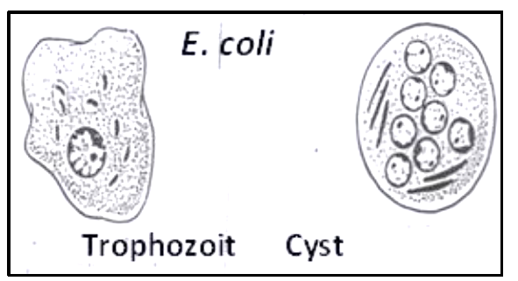
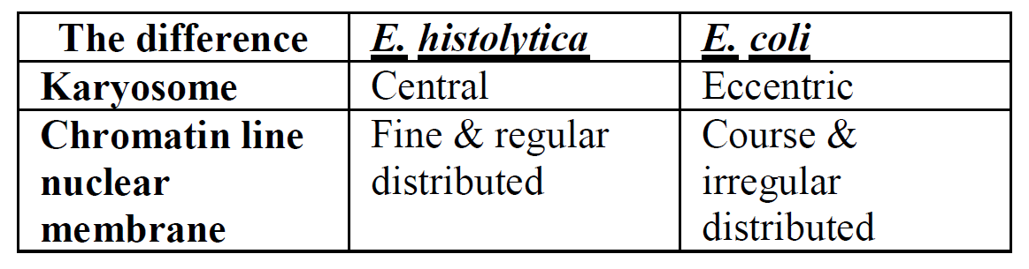
Entamoeba coli

Slide 9
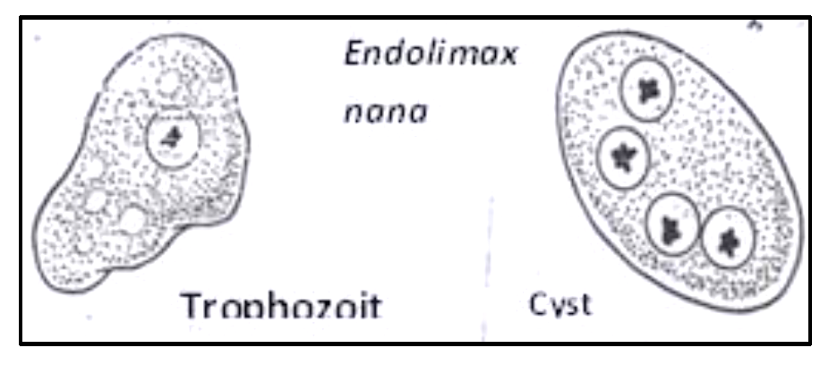
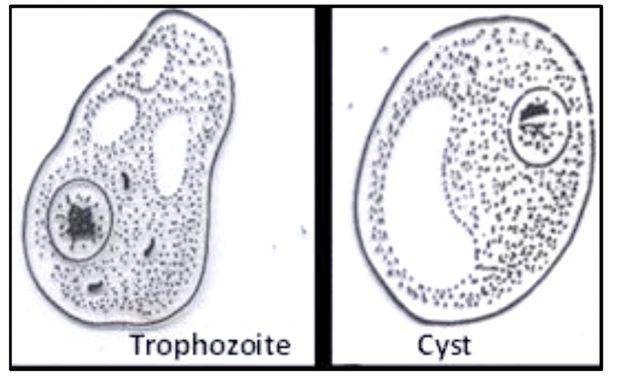
2- Endolimax nana
3-Iodamoeba buetschlii

Slide 10
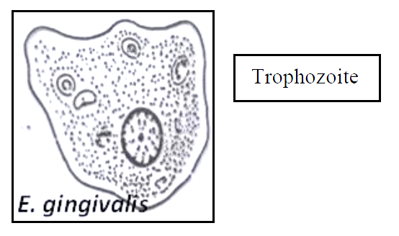
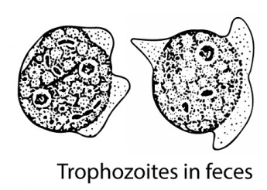
4- Entamoeba gingivalis
Dientamoeba fragilis
Trophozoites in stool

